Slide 1
RAC Database Administration

Slide 2
Objectives
After completing this lesson, you should be able to:
  Use Enterprise Manager cluster database pages
  Define redo log files in a RAC environment
  Define undo tablespaces in a RAC environment
  Start and stop RAC databases and instances
  Modify initialization parameters in a RAC environment
  Manage ASM instances in a RAC environment
Notes:
Oracle Database 11g: RAC Administration 4 - <number>

Slide 3
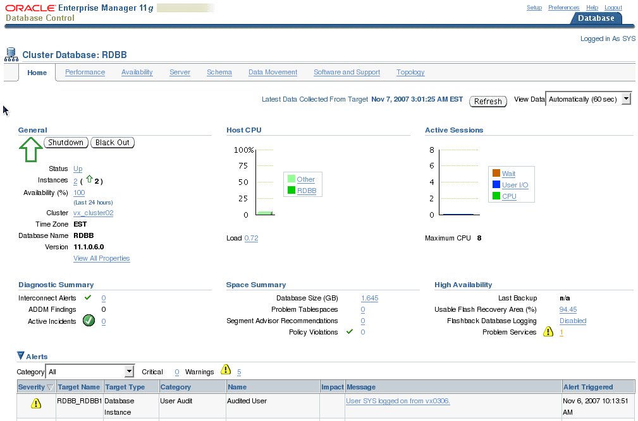
Cluster Database Home Page
Notes:
Oracle Database 11g: RAC Administration 4 - <number>
Cluster Database Home Page
The Cluster Database home page serves as a crossroad for managing and monitoring all aspects of your RAC database. From this page, you can access the other main cluster database tabs: Performance, Availability, Server, Schema, Data Movement, Software and Support, and Topology.
On this page, you find General, High Availability, Space Summary, and Diagnostic Summary sections for information that pertains to your cluster database as a whole. The number of instances is displayed for the RAC database, in addition to the status. A RAC database is considered to be up if at least one instance has the database open. You can access the Cluster home page by clicking the Cluster link in the General section of the page.
Other items of interest include the date of the last RMAN backup, archiving information, space utilization, and an alert summary. By clicking the link next to the Flashback Database Logging label, you can go to the Recovery Settings page from where you can change various recovery parameters.
The Alerts table shows all open recent alerts. Click the alert message in the Message column for more information about the alert. When an alert is triggered, the name of the metric for which the alert was triggered is displayed in the Name column.

Slide 4
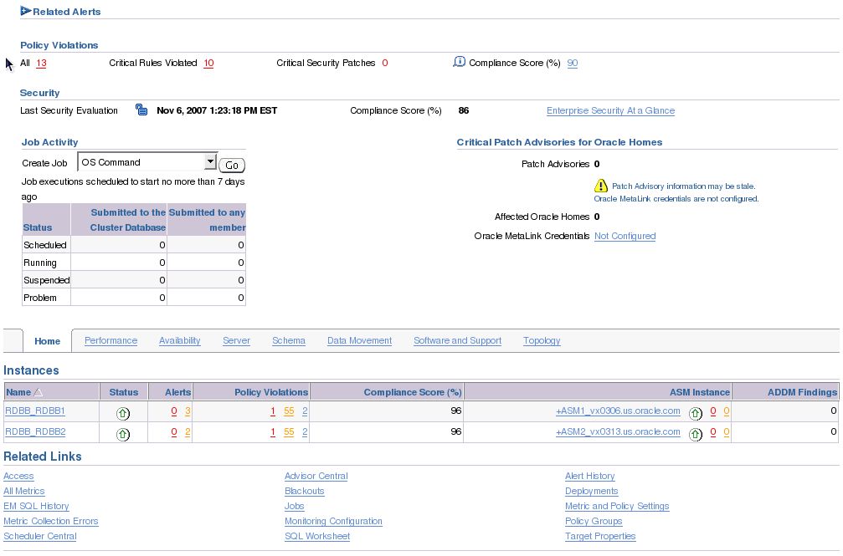
Cluster Database Home Page
Notes:
Oracle Database 11g: RAC Administration 4 - <number>
Cluster Database Home Page (continued)
The Related Alerts table provides information about alerts for related targets, such as Listeners and Hosts, and contains details about the message, the time the alert was triggered, the value, and the time the alert was last checked.
The Policy Trend Overview page (accessed by clicking the Compliance Score link) provides a comprehensive view about a group or targets containing other targets with regard to compliance over a period of time. Using the tables and graphs, you can easily watch for trends in progress and changes.
The Security At a Glance page shows an overview of the security health of the enterprise for all the targets or specific groups. This helps you to quickly focus on security issues by showing statistics about security policy violations and noting the critical security patches that have not been applied.
The Job Activity table displays a report of the job executions that shows the scheduled, running, suspended, and problem (stopped/failed) executions for all Enterprise Manager jobs on the cluster database.
The Instances table lists the instances for the cluster database, their availability, alerts, policy violations, performance findings, and related ASM Instance. Click an instance name to go to the home page for that instance. Click the links in the table to get more information about a particular alert, advice, or metric.

Slide 5
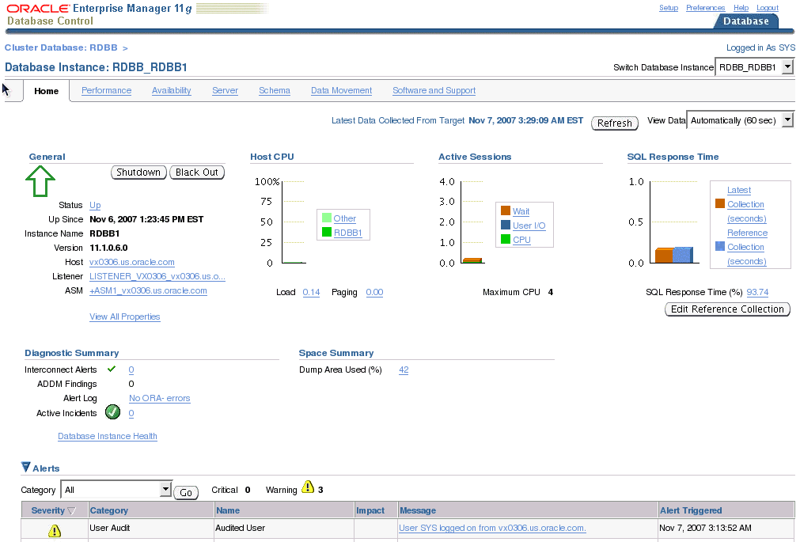
Cluster Database Instance Home Page
Notes:
Oracle Database 11g: RAC Administration 4 - <number>
Cluster Database Instance Home Page
The Cluster Database Instance home page enables you to view the current state of the instance by displaying a series of metrics that portray its overall health. This page provides a launch point for the performance, administration, and maintenance of the instance environment.
You can access the Cluster Database Instance home page by clicking one of the instance names from the Instances section of the Cluster Database home page. This page has basically the same sections as the Cluster Database home page.
The difference is that tasks and monitored activities from these pages apply primarily to a specific instance. For example, clicking the Shutdown button from this page shuts down only this one instance. However, clicking the Shutdown button from the Cluster Database home page gives you the option of shutting down all or specific instances.
By scrolling down on this page, you see the Alerts, Related Alerts, Policy Violations, Jobs Activity, and Related Links sections. These provide similar information similar to that provided in the same sections in the Cluster Database home page.

Slide 6
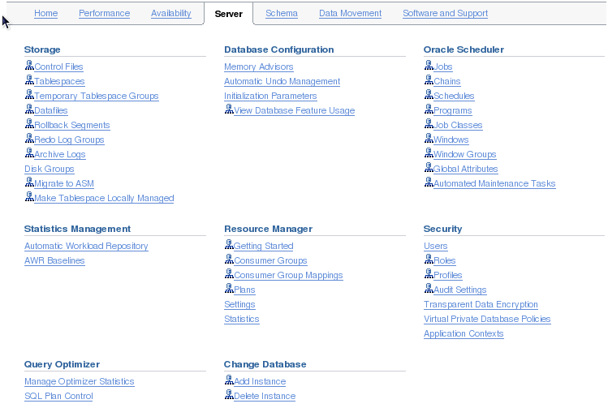
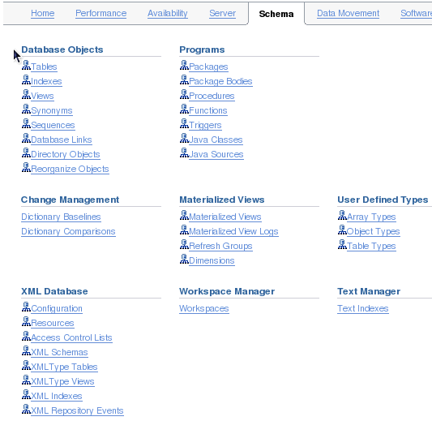
Cluster Database Instance Administration Page
Notes:
Oracle Database 11g: RAC Administration 4 - <number>
Cluster Database Instance Administration Page
This is the classical Administration page with an important difference with its corresponding single-instance version. As you can see it on the screenshot, each database-level related task is prefixed with a small icon representing a cluster database.

Slide 7
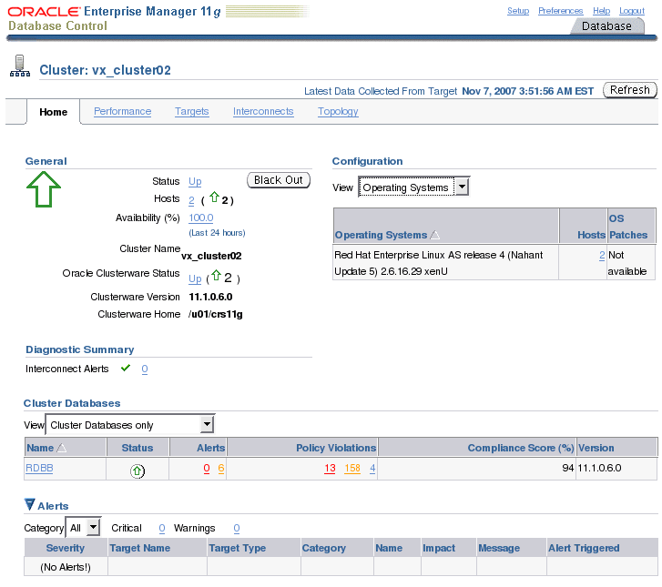
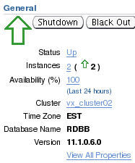
Cluster Home Page
Notes:
Oracle Database 11g: RAC Administration 4 - <number>
Cluster Home Page
The slide shows you the Cluster home page, which can be accessed by clicking the Cluster link located in the General section of the Cluster Database home page. The cluster is represented as a composite target composed of nodes and cluster databases. An overall summary of the cluster is provided here.
The Cluster home page displays several sections, including General, Configuration, Cluster Databases, Alerts, and Hosts.
The General section provides a quick view of the status of the cluster, providing basic information such as current Status, Availability, Up nodes, and Clusterware Home and Version.
The Configuration section allows you to view the operating systems (including Hosts and OS Patches) and hardware (including Hardware configuration and Hosts) for the cluster.
The Cluster Databases table displays the cluster databases (optionally associated with corresponding services) associated with this cluster, their availability, and any alerts on those databases. The Alerts table provides information about any alerts that have been issued along with the severity rating of each.
The Hosts table (not shown on the screenshot) displays the hosts for the cluster, their availability, corresponding alerts, CPU and memory utilization percentage, and total I/O per second.

Slide 8
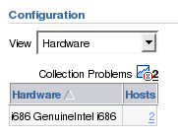
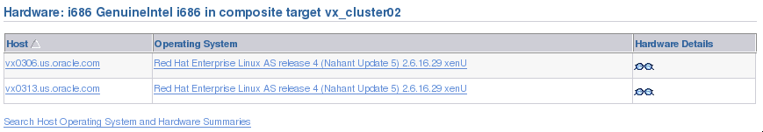
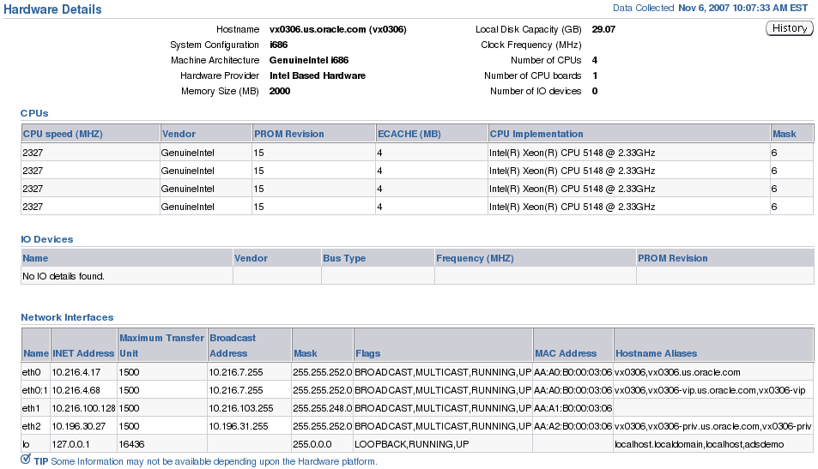
The Configuration Section
Notes:
Oracle Database 11g: RAC Administration 4 - <number>
The Configuration Section
The Cluster home page is invaluable for locating configuration-specific data. Locate the Configuration section on the Cluster home page. The View drop-down list allows you to inspect hardware and operating system overview information.
Click the Hosts link, and then click the Hardware Details link of the host that you want. On the Hardware Details page, you find detailed information regarding your CPU, disk controllers, network adapters, and so on. This information can be very useful when determining the Linux patches for your platform.
Click History to access the hardware history information for the host.
Some hardware information is not available, depending on the hardware platform.
Note: The Local Disk Capacity (GB) field shows the disk space that is physically attached (local) to the host. This value does not include disk space that may be available to the host through networked file systems.

Slide 9
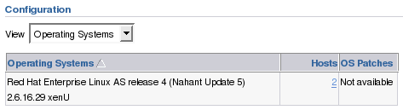
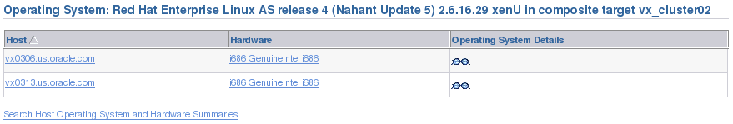
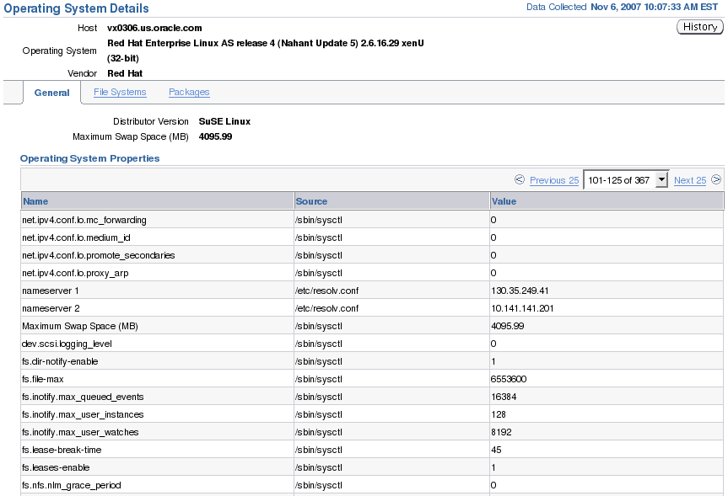
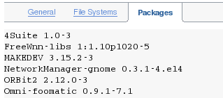
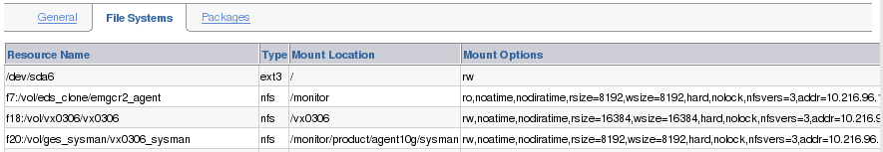
The Configuration Section
Notes:
Oracle Database 11g: RAC Administration 4 - <number>
The Configuration Section (continued)
The Operating System Details General page displays operating system details for a host, including:
General information, such as the distributor version and the maximum swap space of the operating system
Information about operating system properties
The Source column displays where Enterprise Manager obtained the value for each operating system property.
To see a list of changes to the operating system properties, click History.
The Operating System Details File Systems page displays information about one or more file systems for the selected hosts:
Name of the file system on the host
Type of mounted file system, for example, ufs or nfs
Directory where the file system is mounted
The mount options for the file system, for example ro, nosuid, or nobrowse
The Operating System Details Packages page displays information about the operating system packages that have been installed on a host.

Slide 10
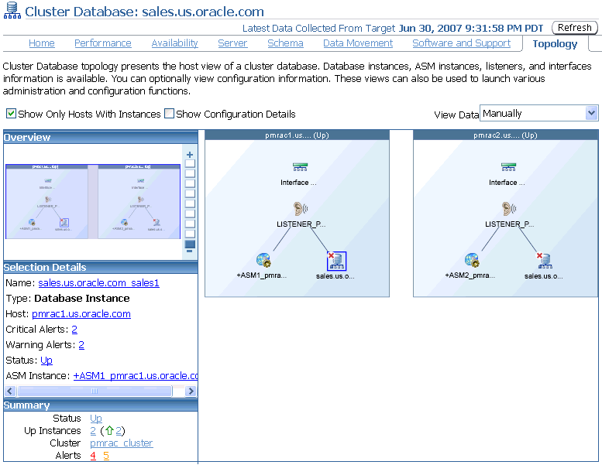
Topology Viewer
Notes:
Oracle Database 11g: RAC Administration 4 - <number>
Topology Viewer
The Oracle Enterprise Manager Topology Viewer enables you to visually see the relationships between target types for each host of your cluster database. You can zoom in or out, pan, and see selection details. These views can also be used to launch various administration functions.
The Topology Viewer populates icons on the basis of your system configuration. If a listener is serving an instance, a line connects the listener icon and the instance icon. Possible target types are:
Interface
Listener
ASM Instance
Database Instance
If the Show Configuration Details option is not selected, the topology shows the monitoring view of the environment, which includes general information such as alerts and overall status. If you select the Show Configuration Details option, additional details are shown in the Selection Details window, which are valid for any topology view. For instance, the Listener component would also show the machine name and port number.
You can click an icon and then right-click to display a menu of available actions.

Slide 11
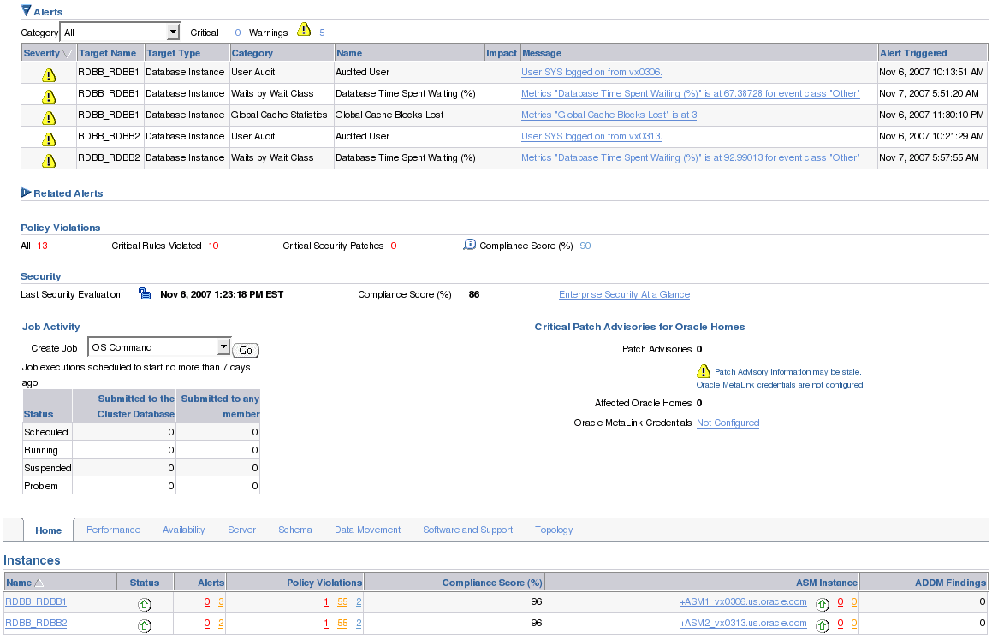
Enterprise Manager Alerts and RAC
Notes:
Oracle Database 11g: RAC Administration 4 - <number>
Enterprise Manager Alerts and RAC
You can use Enterprise Manager to administer alerts for RAC environments. Enterprise Manager distinguishes between database- and instance-level alerts in RAC environments.
Enterprise Manager also responds to metrics from across the entire RAC database and publishes alerts when thresholds are exceeded. Enterprise Manager interprets both predefined and customized metrics. You can also copy customized metrics from one cluster database instance to another, or from one RAC database to another. A recent alert summary can be found on the Database Control home page. Notice that alerts are sorted by relative time and target name.

Slide 12
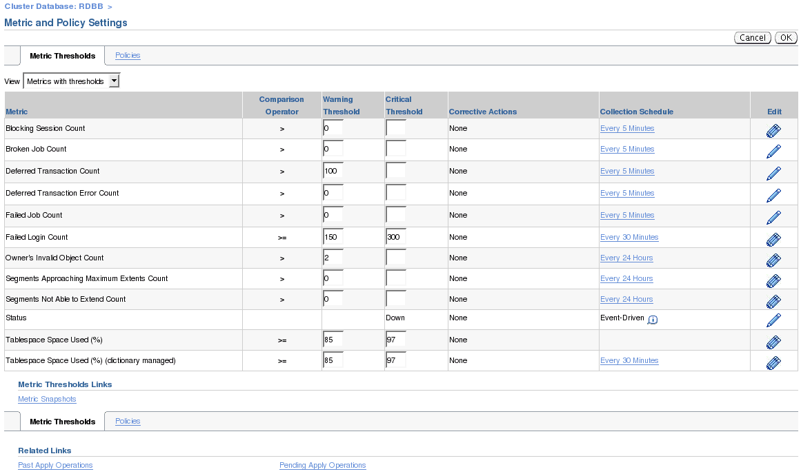
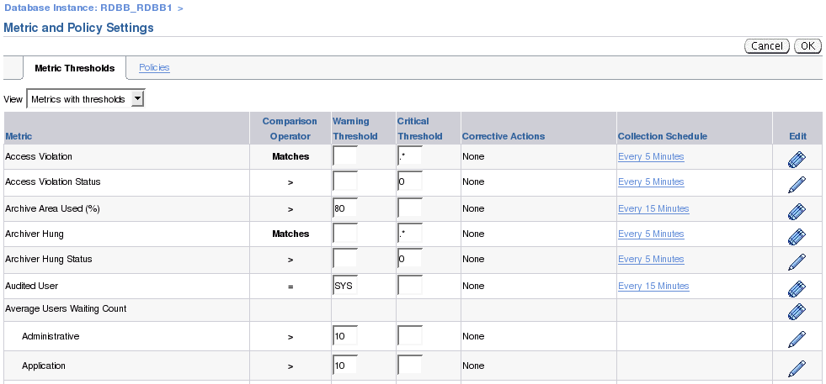
Enterprise Manager Metrics and RAC
Notes:
Oracle Database 11g: RAC Administration 4 - <number>
Enterprise Manager Metrics and RAC
Alert thresholds for instance-level alerts, such as archive log alerts, can be set at the instance target level. This enables you to receive alerts for the specific instance if performance exceeds your threshold. You can also configure alerts at the database level, such as setting alerts for tablespaces. This enables you to avoid receiving duplicate alerts at each instance.

Slide 13
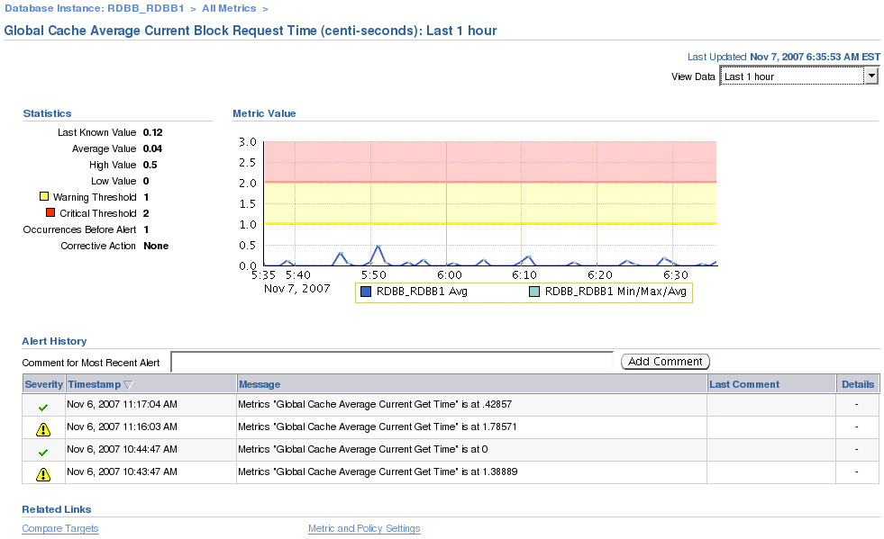
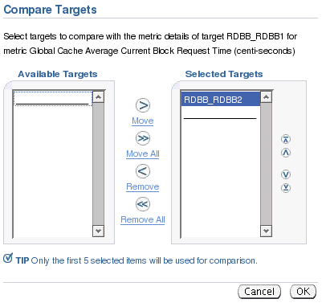
Enterprise Manager Metrics and RAC
Notes:
Oracle Database 11g: RAC Administration 4 - <number>
Enterprise Manager Metrics and RAC (continued)
It is also possible to view the metric across the cluster in a comparative or overlay fashion. To view this information, click the Compare Targets link at the bottom of the corresponding metric page. When the Compare Targets page appears, choose the instance targets that you want to compare by selecting them and then clicking the Move button. If you want to compare the metric data from all targets, then click the Move All button. After making your selections, click the OK button to continue.
The Metric summary page appears next. Depending on your needs, you can accept the default timeline of 24 hours or select a more suitable value from the View Data drop-down list. If you want to add a comment regarding the event for future reference, then enter a comment in the Comment for Most Recent Alert field, and then click the Add Comment button.

Slide 14
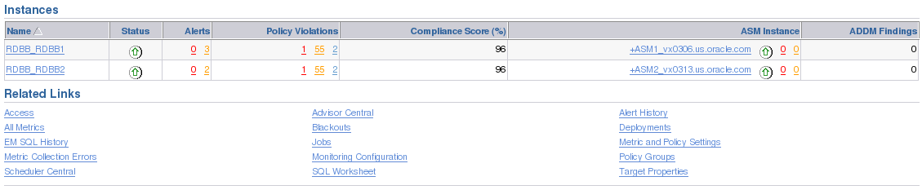
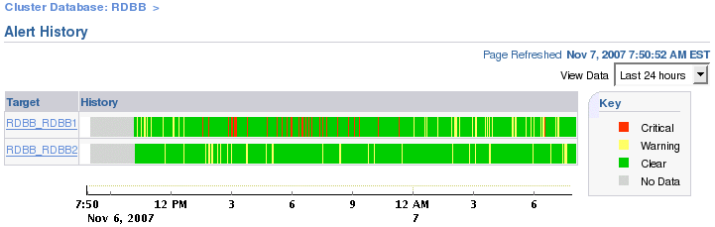
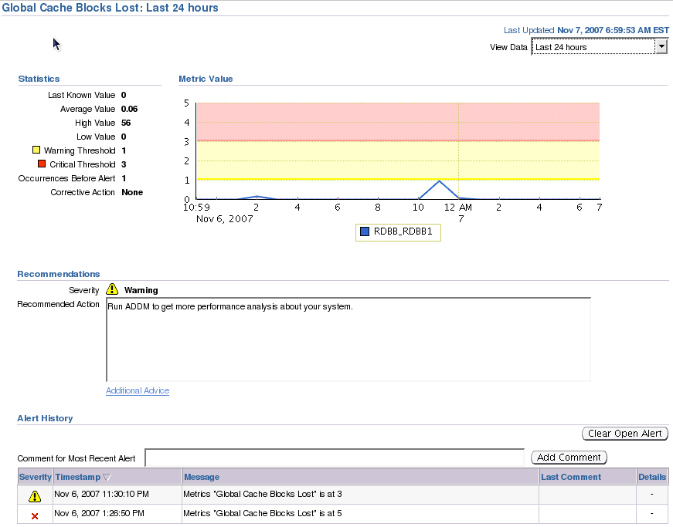
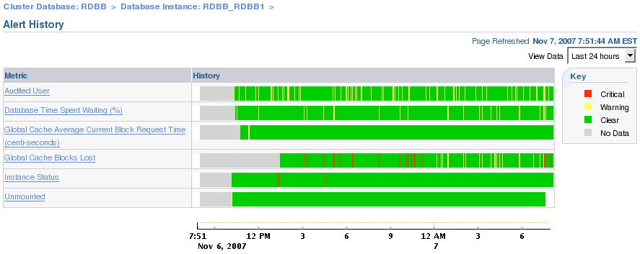
Enterprise Manager Alert History and RAC
Notes:
Oracle Database 11g: RAC Administration 4 - <number>
Enterprise Manager Alert History and RAC
In a RAC environment, you can see a summary of the alert history for each participating instance directly from the Cluster Database home page. The drill-down process is shown in the slide. You click the Alert History link in the Related Links section of the Cluster Database home page. This takes you to the Alert History page on which you can see the summary for both instances in the example. You can then click one of the instance’s links to go to the corresponding Alert History page for that instance. From there, you can access a corresponding alert page by choosing the alert of your choice.

Slide 15
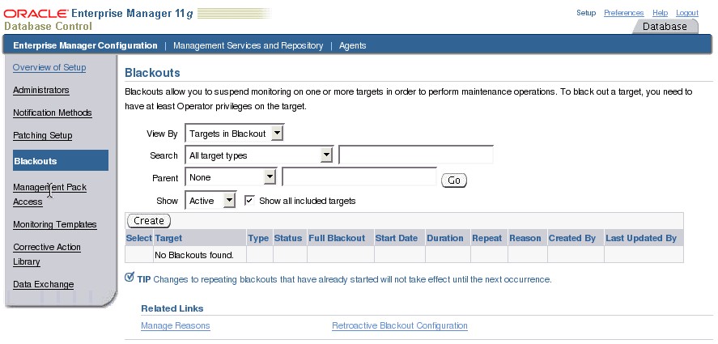
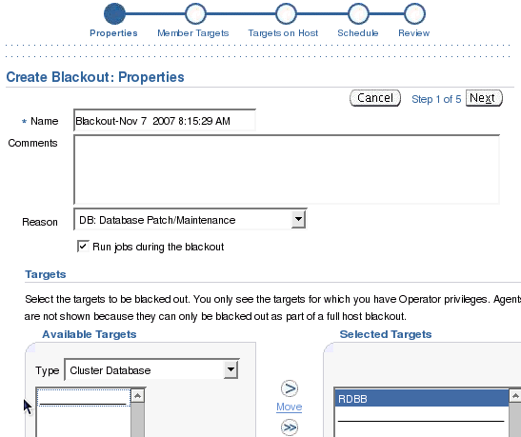
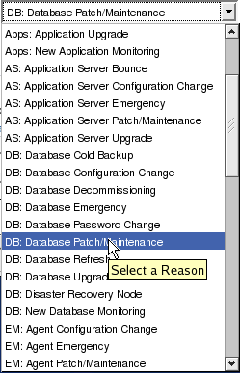
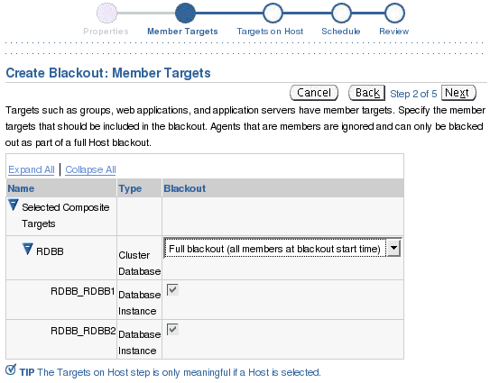
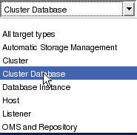

Enterprise Manager Blackouts and RAC
Notes:
Oracle Database 11g: RAC Administration 4 - <number>
Enterprise Manager Blackouts and RAC
You can use Enterprise Manager to define blackouts for all managed targets of your RAC database to prevent alerts from being recorded. Blackouts are useful when performing scheduled or unscheduled maintenance or other tasks that might trigger extraneous or unwanted events. You can define blackouts for an entire cluster database or for specific cluster database instances.
To create a blackout event, click the Setup link on top of any Enterprise Manager page. Then, click the Blackouts link on the left. The Blackouts page appears.
Click the Create button. The Create Blackout: Properties page appears. You must enter a name or tag in the Name field. If you want, you can also enter a descriptive comment in the Comments field. This is optional. Enter a reason for the blackout in the Reason field.
In the Targets area of the Properties page, you must choose a target Type from the drop-down list. In the example in the slide, the entire cluster database RDBB is chosen. Click the cluster database in the Available Targets list, and then click the Move button to move your choice to the Selected Targets list. Click the Next button to continue.
The Member Targets page appears next. Expand the Selected Composite Targets tree and ensure that all targets that must be included appear in the list. Continue and define your schedule as you normally would.

Slide 16
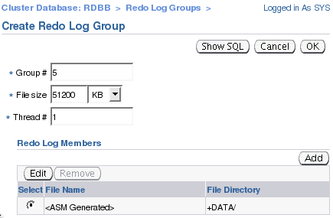
Redo Log Files and RAC
Node1
Node2
RAC01
RAC02
Shared storage
SPFILE
Group 1
…
RAC01.THREAD=1
RAC02.THREAD=2
…
Group 4
Group 2
Group 5
Group 3
Thread 2
Thread 1
ALTER DATABASE ADD LOGFILE THREAD 2 GROUP 4;
ALTER DATABASE ADD LOGFILE THREAD 2 GROUP 5;
ALTER DATABASE ENABLE THREAD 2;
Notes:
Oracle Database 11g: RAC Administration 4 - <number>
Redo Log Files and RAC
With Real Application Clusters (RAC), each instance writes to its own set of online redo log files, and the redo written by an instance is called a thread of redo, or thread. Thus, each redo log file group used by an instance is associated with the same thread number determined by the value of the THREAD initialization parameter. If you set the THREAD parameter to a nonzero value for a particular instance, the next time the instance is started, it will try to use that thread. Because an instance can use a thread as long as that thread is enabled, and not in use by another instance, it is recommended to set the THREAD parameter to a nonzero value with each instance having different values.
You associate a thread number with a redo log file group by using the ALTER DATABASE ADD LOGFILE THREAD statement. You enable a thread number by using the ALTER DATABASE ENABLE THREAD statement. Before you can enable a thread, it must have at least two redo log file groups.
By default, a database is created with one enabled public thread. An enabled public thread is a thread that has been enabled by using the ALTER DATABASE ENABLE PUBLIC THREAD statement. Such a thread can be acquired by an instance with its THREAD parameter set to zero. Therefore, you need to create and enable additional threads when you add instances to your database.
The maximum possible value for the THREAD parameter is the value assigned to the MAXINSTANCES parameter specified in the CREATE DATABASE statement.
Note: You can use Enterprise Manager to administer redo log groups in a RAC environment.

Slide 17
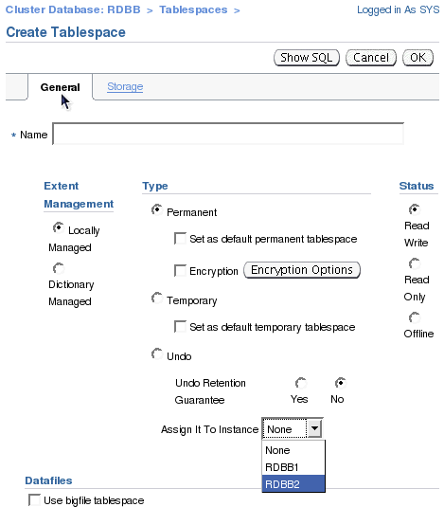
Automatic Undo Management and RAC
Pending
offline
Node1
Node2
RAC01
RAC02
Consistent reads
Transaction recovery
Shared storage
SPFILE
undotbs3
…
RAC01.UNDO_TABLESPACE=undotbs3
RAC02.UNDO_TABLESPACE=undotbs2
…
undotbs1
undotbs2
ALTER SYSTEM SET UNDO_TABLESPACE=undotbs3 SID='RAC01';
Notes:
Oracle Database 11g: RAC Administration 4 - <number>
Automatic Undo Management in RAC
The Oracle database automatically manages undo segments within a specific undo tablespace that is assigned to an instance. Under normal circumstances, only the instance assigned to the undo tablespace can modify the contents of that tablespace. However, all instances can always read all undo blocks for consistent-read purposes. Also, any instance can update any undo tablespace during transaction recovery, as long as that undo tablespace is not currently used by another instance for undo generation or transaction recovery.
You assign undo tablespaces in your RAC database by specifying a different value for the UNDO_TABLESPACE parameter for each instance in your SPFILE or individual PFILEs. If you do not set the UNDO_TABLESPACE parameter, then each instance uses the first available undo tablespace. If undo tablespaces are not available, the SYSTEM rollback segment is used.
You can dynamically switch undo tablespace assignments by executing the ALTER SYSTEM SET UNDO_TABLESPACE statement with the SID clause. You can run this command from any instance. In the example shown in the slide, the previously used undo tablespace assigned to instance RAC01 remains assigned to it until the RAC01 instance’s last active transaction commits. The pending offline tablespace may be unavailable for other instances until all transactions against that tablespace are committed.
Note: You cannot simultaneously use Automatic Undo Management (AUM) and manual undo management in a RAC database. It is highly recommended that you use the AUM mode.

Slide 18
Starting and Stopping RAC Instances
  Multiple instances can open the same database simultaneously.
  Shutting down one instance does not interfere with other running instances.
  SHUTDOWN TRANSACTIONAL LOCAL does not wait for other instances’ transactions to finish.
  RAC instances can be started and stopped by using:
    Enterprise Manager
    Server Control (SRVCTL) utility
    SQL*Plus
  Shutting down a RAC database means shutting down all instances accessing the database.
Notes:
Oracle Database 11g: RAC Administration 4 - <number>
Starting and Stopping RAC Instances
In a RAC environment, multiple instances can have the same RAC database open at the same time. Also, shutting down one instance does not interfere with the operation of other running instances.
The procedures for starting up and shutting down RAC instances are identical to the procedures used in single-instance Oracle, with the following exception:
The SHUTDOWN TRANSACTIONAL command with the LOCAL option is useful to shut down an instance after all active transactions on the instance have either committed or rolled back. Transactions on other instances do not block this operation. If you omit the LOCAL option, then this operation waits until transactions on all other instances that started before the shutdown are issued either a COMMIT or a ROLLBACK.
You can start up and shut down instances by using Enterprise Manager, SQL*Plus, or Server Control (SRVCTL). Both Enterprise Manager and SRVCTL provide options to start up and shut down all the instances of a RAC database with a single step.
Shutting down a RAC database mounted or opened by multiple instances means that you need to shut down every instance accessing that RAC database. However, having only one instance opening the RAC database is enough to declare the RAC database open.

Slide 19
Starting and Stopping
RAC Instances with SQL*Plus
[stc-raclin01] $ echo $ORACLE_SID
RACDB1
sqlplus / as sysdba
SQL> startup
SQL> shutdown
[stc-raclin02] $ echo $ORACLE_SID
RACDB2
sqlplus / as sysdba
SQL> startup
SQL> shutdown
OR
[stc-raclin01] $sqlplus / as sysdba
SQL> startup
SQL> shutdown
SQL> connect sys/oracle@RACDB2 as sysdba
SQL> startup
SQL> shutdown
Notes:
Oracle Database 11g: RAC Administration 4 - <number>
Starting and Stopping RAC Instances with SQL*Plus
If you want to start up or shut down only one instance, and if you are connected to your local node, you must first ensure that your current environment includes the SID for the local instance.
To start up or shut down your local instance, initiate a SQL*Plus session connected as SYSDBA or SYSOPER, and then issue the required command (for example, STARTUP).
You can start multiple instances from a single SQL*Plus session on one node by way of Oracle Net Services. To achieve this, you must connect to each instance by using a Net Services connection string (typically an instance-specific alias from your tnsnames.ora file).
For example, you can use a SQL*Plus session on a local node to shut down two instances on remote nodes by connecting to each using the instance’s individual alias name.
The example in the slide assumes that the alias name for the second instance is RACDB2. In the example, there is no need to connect to the first instance using its connect descriptor because the command is issued from the first node with the correct ORACLE_SID.
It is not possible to start up or shut down more than one instance at a time in SQL*Plus, so you cannot start or stop all the instances for a cluster database with a single SQL*Plus command.
To verify that instances are running, on any node, look at V$ACTIVE_INSTANCES.
Note: SQL*Plus is integrated with Oracle Clusterware to make sure that corresponding resources are correctly handled during startup and shutdown of instances by using SQL*Plus.

Slide 20
Starting and Stopping
RAC Instances with SRVCTL
  start/stop syntax:
  Examples:
srvctl start|stop instance -d <db_name> -i <inst_name_list>
[-o open|mount|nomount|normal|transactional|immediate|abort>]
[-c <connect_str> | -q]
srvctl start|stop database -d <db_name>
[-o open|mount|nomount|normal|transactional|immediate|abort>] [-c <connect_str> | -q]
$ srvctl start instance -d RACDB -i RACDB1,RACDB2
$ srvctl stop instance -d RACDB -i RACDB1,RACDB2
$ srvctl start database -d RACDB -o open
Notes:
Oracle Database 11g: RAC Administration 4 - <number>
Starting and Stopping RAC Instances with SRVCTL
The srvctl start database command starts a cluster database, its enabled instances, and its services. The srvctl stop database command stops a database, its instances, and its services.
The srvctl start instance command starts instances of a cluster database. This command also starts all enabled and nonrunning services that have the listed instances either as preferred or as available instances.
The srvctl stop instance command stops instances as well as all enabled and running services that have these instances as either preferred or available instances.
You must disable an object that you intend to keep stopped after you issue a srvctl stop command; otherwise, Oracle Clusterware (OC) can restart it as a result of another planned operation. For commands that use a connect string, if you do not provide a connect string, then SRVCTL uses / as sysdba to perform the operation. The –q option asks for a connect string from standard input. SRVCTL does not support concurrent executions of commands on the same object. Therefore, run only one SRVCTL command at a time for each database, service, or other object. |
To use the START and STOP options of the SRVCTL command, your service must be an
OC-enabled, nonrunning service.
Note: For more information, see the Oracle Clusterware Administration and Deployment Guide and the Oracle Real Application Clusters Administration and Deployment Guide.

Slide 21
Switch Between the Automatic and Manual Policies
$ srvctl config database -d RACB -a
ex0044 RACB1 /u01/app/oracle/product/10.2.0/db_1
ex0045 RACB2 /u01/app/oracle/product/10.2.0/db_1
DB_NAME: RACB
ORACLE_HOME: /u01/app/oracle/product/10.2.0/db_1
SPFILE: +DGDB/RACB/spfileRACB.ora
DOMAIN: null
DB_ROLE: null
START_OPTIONS: null
POLICY: AUTOMATIC
ENABLE FLAG: DB ENABLED
$
srvctl modify database -d RACB -y MANUAL;
Notes:
Oracle Database 11g: RAC Administration 4 - <number>
Switch Between the Automatic and Manual Policies
By default, Oracle Clusterware is configured to start the VIP, listener, instance, ASM, database services, and other resources during system boot. It is possible to modify some resources to have their AUTO_START profile parameter set to the value 2. This means that after node reboot, or when Oracle Clusterware is started, resources with AUTO_START=2 need to be started manually via srvctl. This is designed to assist in problem troubleshooting and system maintenance. Starting with Oracle Database 10g Release 2, when changing resource profiles through srvctl, the command tool automatically modifies the profile attributes of other dependent resources given the current prebuilt dependencies. The command to accomplish this is:
srvctl modify database -d <dbname> -y AUTOMATIC|MANUAL
To implement Oracle Clusterware and Real Application Clusters, it is best to have Oracle Clusterware start the defined Oracle resources during system boot, which is the default. The first example in the slide uses the srvctl config database command to display the current policy for the RACB database. As you can see, it is currently set to its default: AUTOMATIC. The second statement uses the srvctl modify database command to change the current policy to MANUAL for the RACB database. When you add a new database by using the srvctl add database command, that database is by default placed under the control of Oracle Clusterware using the AUTOMATIC policy. However, you can use the following statement to directly set the policy to MANUAL: srvctl add database -d RACZ -y MANUAL.
Note: You can also use this procedure to configure your system to prevent Oracle Clusterware from autorestarting failed database instances more than once.

Slide 22

RAC Initialization Parameter Files
  An SPFILE is created if you use the DBCA.
  The SPFILE must be created on a shared volume or shared raw device.
  All instances use the same SPFILE.
  If the database is created manually, then create an SPFILE from a PFILE.
Node1
Node2
RAC01
RAC02
initRAC01.ora
initRAC02.ora
SPFILE=…
SPFILE=…
SPFILE
Notes:
Oracle Database 11g: RAC Administration 4 - <number>
Initialization Parameter Files
When you create the database, the DBCA creates an SPFILE in the file location that you specify. This location can be an Automatic Storage Management (ASM) disk group, cluster file system file, or a shared raw device. If you manually create your database, then it is recommended to create an SPFILE from a PFILE.
All instances in the cluster database use the same SPFILE at startup. Because the SPFILE is a binary file, do not edit it. Instead, change the SPFILE parameter settings by using Enterprise Manager or ALTER SYSTEM SQL statements.
RAC uses a traditional PFILE only if an SPFILE does not exist or if you specify PFILE in your STARTUP command. Using SPFILE simplifies administration, maintaining parameter settings consistent, and guarantees parameter settings persistence across database shutdown and startup. In addition, you can configure RMAN to back up your SPFILE.
In order for each instance to use the same SPFILE at startup, each instance uses its own PFILE file that contains only one parameter called SPFILE. The SPFILE parameter points to the shared SPFILE on your shared storage. This is illustrated in the slide. By naming each PFILE using the init<SID>.ora format, and by putting them in the $ORACLE_HOME/dbs directory of each node, a STARTUP command uses the shared SPFILE.

Slide 23
SPFILE Parameter Values and RAC
  You can change parameter settings using the ALTER SYSTEM SET command from any instance:
  SPFILE entries such as:
    *.<pname> apply to all instances
    <sid>.<pname> apply only to <sid>
    <sid>.<pname> takes precedence over *.<pname>
  Use current or future *.<dpname> settings for <sid>:
  Remove an entry from your SPFILE:
ALTER SYSTEM SET <dpname> SCOPE=MEMORY sid='<sid|*>';
ALTER SYSTEM RESET <dpname> SCOPE=MEMORY sid='<sid>';
ALTER SYSTEM RESET <dpname> SCOPE=SPFILE sid='<sid|*>';
Notes:
Oracle Database 11g: RAC Administration 4 - <number>
SPFILE Parameter Values and RAC
You can modify the value of your initialization parameters by using the ALTER SYSTEM SET command. This is the same as with a single-instance database except that you have the possibility to specify the SID clause in addition to the SCOPE clause.
By using the SID clause, you can specify the SID of the instance where the value takes effect. Specify SID='*' if you want to change the value of the parameter for all instances. Specify SID='sid' if you want to change the value of the parameter only for the instance sid. This setting takes precedence over previous and subsequent ALTER SYSTEM SET statements that specify SID='*'. If the instances are started up with an SPFILE, then SID='*' is the default if you do not specify the SID clause.
If you specify an instance other than the current instance, then a message is sent to that instance to change the parameter value in its memory if you are not using the SPFILE scope.
The combination of SCOPE=MEMORY and SID='sid' of the ALTER SYSTEM RESET command allows you to override the precedence of a currently used <sid>.<dparam> entry. This allows for the current *.<dparam> entry to be used, or for the next created *.<dparam> entry to be taken into account on that particular sid.
Using the last example, you can remove a line from your SPFILE.

Slide 24
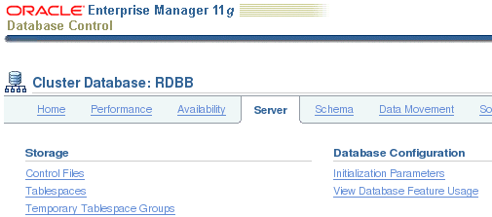
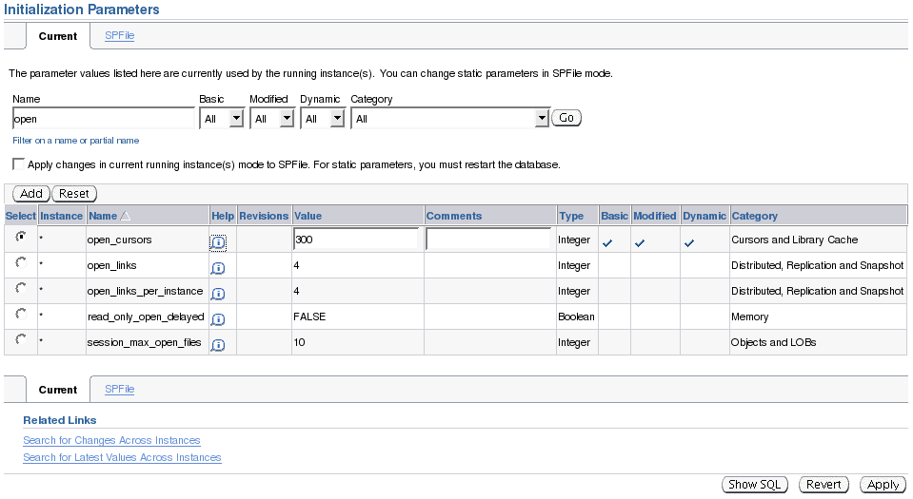
EM and SPFILE Parameter Values
SCOPE=MEMORY
Notes:
Oracle Database 11g: RAC Administration 4 - <number>
EM and SPFILE Parameter Values
You can access the Initialization Parameters page by clicking the Initialization Parameters link on the Cluster Database Server page.
The Current tabbed page shows you the values currently used by the initialization parameters of all the instances accessing the RAC database. You can filter the Initialization Parameters page to show only those parameters that meet the criteria of the filter that you entered in the Name field.
The Instance column shows the instances for which the parameter has the value listed in the table. An asterisk (*) indicates that the parameter has the same value for all remaining instances of the cluster database.
Choose a parameter from the Select column and perform one of the following steps:
Click Add to add the selected parameter to a different instance. Enter a new instance name and value in the newly created row in the table.
Click Reset to reset the value of the selected parameter. Note that you may reset only those parameters that do not have an asterisk in the Instance column. The value of the selected column is reset to the value of the remaining instances.
Note: For both Add and Reset buttons, the ALTER SYSTEM command uses SCOPE=MEMORY.

Slide 25
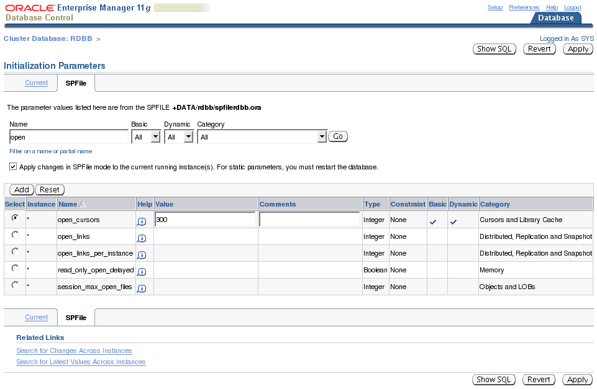
EM and SPFILE Parameter Values
SCOPE=BOTH
SCOPE=SPFILE
Notes:
Oracle Database 11g: RAC Administration 4 - <number>
EM and SPFILE Parameter Values (continued)
The SPFile tabbed page displays the current values stored in your SPFILE.
As on the Current tabbed page, you can add or reset parameters. However, if you select the “Apply changes in SPFile mode” check box, then the ALTER SYSTEM command uses SCOPE=BOTH. If this check box is not selected, SCOPE=SPFILE is used.
Click Apply to accept and generate your changes.

Slide 26
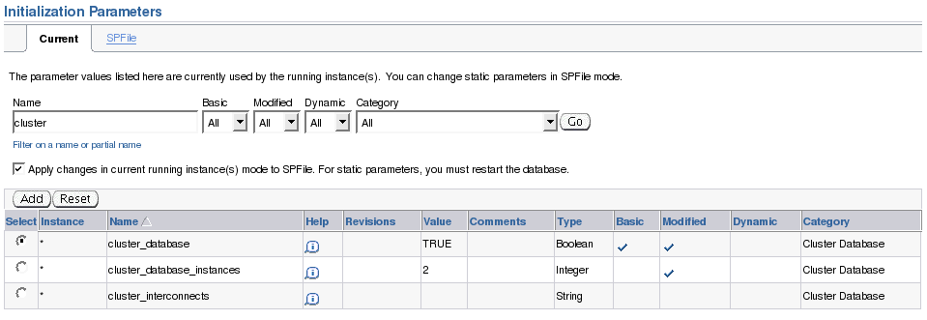
RAC Initialization Parameters
Notes:
Oracle Database 11g: RAC Administration 4 - <number>
RAC Initialization Parameters
CLUSTER_DATABASE: Enables a database to be started in cluster mode. Set this to TRUE.
CLUSTER_DATABASE_INSTANCES: Sets the number of instances in your RAC environment. A proper setting for this parameter can improve memory use.
CLUSTER_INTERCONNECTS: Specifies the cluster interconnect when there is more than one interconnect. Refer to your Oracle platform-specific documentation for the use of this parameter, its syntax, and its behavior. You typically do not need to set the CLUSTER_INTERCONNECTS parameter. For example, do not set this parameter for the following common configurations:
If you have only one cluster interconnect
If the default cluster interconnect meets the bandwidth requirements of your RAC database, which is typically the case
If NIC bonding is being used for the interconnect
When OIFCFG’s global configuration can specify the right cluster interconnects. It only needs to be specified as an override for OIFCFG.
DB_NAME: If you set a value for DB_NAME in instance-specific parameter files, then the setting must be identical for all instances.
DISPATCHERS: Set this parameter to enable a shared-server configuration, that is a server that is configured to allow many user processes to share very few server processes.

Slide 27
Notes only page
Notes:
Oracle Database 11g: RAC Administration 4 - <number>
RAC Initialization Parameters (continued)
With shared-server configurations, many user processes connect to a dispatcher. The DISPATCHERS parameter may contain many attributes. Oracle recommends that you configure at least the PROTOCOL and LISTENER attributes.
PROTOCOL specifies the network protocol for which the dispatcher process generates a listening end point. LISTENER specifies an alias name for the Oracle Net Services listeners. Set the alias to a name that is resolved through a naming method, such as a tnsnames.ora file.
MAX_COMMIT_PROPAGATION_DELAY: This is a RAC-specific parameter. Starting with Oracle Database 10g Release 2, the MAX_COMMIT_PROPAGATION_DELAY parameter is deprecated. By default, commits on one instance are immediately visible on all of the other instances (broadcast on commit propagation). This parameter is retained for backward compatibility only. This parameter specifies the maximum amount of time allowed before the system change number (SCN) held in the System Global Area (SGA) of an instance is refreshed by the log writer process (LGWR). It determines whether the local SCN should be refreshed from the SGA when getting the snapshot SCN for a query. With previous releases, you should not alter the default setting for this parameter except under a limited set of circumstances. For example, under unusual circumstances involving rapid updates and queries of the same data from different instances, the SCN might not be refreshed in a timely manner.
SPFILE: When you use an SPFILE, all RAC database instances must use the SPFILE and the file must be on shared storage.
THREAD: If specified, this parameter must have unique values on all instances. The THREAD parameter specifies the number of the redo thread to be used by an instance. You can specify any available redo thread number as long as that thread number is enabled and is not used.

Slide 28
Parameters That Require Identical Settings
  ACTIVE_INSTANCE_COUNT
  ARCHIVE_LAG_TARGET
  COMPATIBLE
  CLUSTER_DATABASE/CLUSTER_DATABASE_INSTANCE
  CONTROL_FILES
  DB_BLOCK_SIZE
  DB_DOMAIN
  DB_FILES
  DB_NAME
  DB_RECOVERY_FILE_DEST/DB_RECOVERY_FILE_DEST_SIZE
  DB_UNIQUE_NAME
  INSTANCE_TYPE
  PARALLEL_MAX_SERVERS
  REMOTE_LOGIN_PASSWORD_FILE
  MAX_COMMIT_PROPAGATION_DELAY
  TRACE_ENABLED
  UNDO_MANAGEMENT
Notes:
Oracle Database 11g: RAC Administration 4 - <number>
Parameters That Require Identical Settings
Certain initialization parameters that are critical at database creation or that affect certain database operations must have the same value for every instance in RAC. Specify these parameter values in the SPFILE, or in each init_dbname.ora file on each instance. In the list in the slide, each parameter must have the same value on all instances.
Note: The setting for DML_LOCKS and RESULT_CACHE_MAX_SIZE must be identical on every instance only if set to zero. Disabling the result cache on some instances may lead to incorrect results.

Slide 29
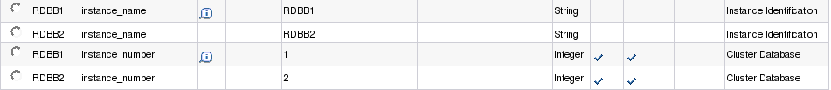
Parameters That Require Unique Settings
    INSTANCE_NUMBER
    UNDO_TABLESPACE
Instance settings:
  THREAD
  ROLLBACK_SEGMENTS
  INSTANCE_NAME
  ASM_PREFERRED_READ_FAILURE_GROUPS
Notes:
Oracle Database 11g: RAC Administration 4 - <number>
Parameters That Require Unique Settings
If you use the THREAD or ROLLBACK_SEGMENTS parameters, it is recommended that you set unique values for them by using the SID identifier in the SPFILE. However, you must set a unique value for INSTANCE_NUMBER for each instance and you cannot use a default value.
The Oracle server uses the INSTANCE_NUMBER parameter to distinguish among instances at startup. The Oracle server uses the THREAD number to assign redo log groups to specific instances. To simplify administration, use the same number for both the THREAD and INSTANCE_NUMBER parameters.
If you specify UNDO_TABLESPACE with Automatic Undo Management enabled, set this parameter to a unique undo tablespace name for each instance.
Using the ASM_PREFERRED_READ_FAILURE_GROUPS initialization parameter, you can specify a list of preferred read failure group names. The disks in those failure groups become the preferred read disks. Thus, every node can read from its local disks. The setting for this parameter is instance specific, and the values do not need to be the same on all instances.

Slide 30
Quiescing RAC Databases
  Use the ALTER SYSTEM QUIESCE RESTRICTED statement from a single instance:
  The database cannot be opened by other instances after the ALTER SYSTEM QUIESCE… statement starts.
  The ALTER SYSTEM QUIESCE RESTRICTED and ALTER SYSTEM UNQUIESCE statements affect all instances in a RAC environment.
  Cold backups cannot be taken when the database is in a quiesced state.
SQL> ALTER SYSTEM QUIESCE RESTRICTED;
Notes:
Oracle Database 11g: RAC Administration 4 - <number>
Quiescing RAC Databases
To quiesce a RAC database, use the ALTER SYSTEM QUIESCE RESTRICTED statement from one instance. It is not possible to open the database from any instance while the database is in the process of being quiesced from another instance. After all non-DBA sessions become inactive, the ALTER SYSTEM QUIESCE RESTRICTED statement executes and the database is considered to be quiesced. In a RAC environment, this statement affects all instances.
The following conditions apply to RAC:
If you had issued the ALTER SYSTEM QUIESCE RESTRICTED statement, but the Oracle server has not finished processing it, then you cannot open the database.
You cannot open the database if it is already in a quiesced state.
The ALTER SYSTEM QUIESCE RESTRICTED and ALTER SYSTEM UNQUIESCE statements affect all instances in a RAC environment, not just the instance that issues the command.
Cold backups cannot be taken when the database is in a quiesced state because the Oracle background processes may still perform updates for internal purposes even when the database is in a quiesced state. Also, the file headers of online data files continue to appear as if they are being accessed. They do not look the same as if a clean shutdown were done.

Slide 31
Terminating Sessions on a Specific Instance
SQL> SELECT SID, SERIAL#, INST_ID
2 FROM GV$SESSION WHERE USERNAME='JFV';
SID SERIAL# INST_ID
---------- ---------- ----------
140 3340 2
SQL> ALTER SYSTEM KILL SESSION '140,3340,@2';
System altered.
SQL>
ALTER SYSTEM KILL SESSION '140,3340,@2'
*
ERROR at line 1:
ORA-00031: session marked for kill
Notes:
Oracle Database 11g: RAC Administration 4 - <number>
Terminating Sessions on a Specific Instance
Starting with Oracle RAC 11gR1, you can use the ALTER SYSTEM KILL SESSION statement to terminate a session on a specific instance.
The slide illustrates this by terminating a session started on a different instance than the one used to terminate the problematic session.
If the session is performing some activity that must be completed (such as waiting for a reply from a remote database or rolling back a transaction), Oracle Database waits for this activity to complete, marks the session as terminated, and then returns control to you. If the waiting lasts a minute, then Oracle Database marks the session to be terminated and returns control to you with a message that the session is marked to be terminated. The PMON background process then marks the session as terminated when the activity is complete.
Note: You can also use the IMMEDIATE clause at the end of the ALTER SYSTEM command to immediately terminate the session without waiting for outstanding activity to complete.

Slide 32
How SQL*Plus Commands Affect Instances
SQL*Plus Command | Associated Instance
ARCHIVE LOG | Generally affects the current instance
CONNECT | Affects the default instance if no instance is specified in the CONNECT command
HOST | Affects the node running the SQL*Plus session
RECOVER | Does not affect any particular instance, but rather the database
SHOW PARAMETER and SHOW SGA | Show the current instance parameter and SGA information
STARTUP and SHUTDOWN | Affect the current instance
SHOW INSTANCE | Displays information about the current instance
Notes:
Oracle Database 11g: RAC Administration 4 - <number>
How SQL*Plus Commands Affect Instances
Most SQL statements affect the current instance. You can use SQL*Plus to start and stop instances in the RAC database. You do not need to run SQL*Plus commands as root on UNIX-based systems or as Administrator on Windows-based systems. You need only the proper database account with the privileges that you normally use for single-instance Oracle database administration. The following are some examples of how SQL*Plus commands affect instances:
The ALTER SYSTEM SET CHECKPOINT LOCAL statement affects only the instance to which you are currently connected, rather than the default instance or all instances.
ALTER SYSTEM CHECKPOINT LOCAL affects the current instance.
ALTER SYSTEM CHECKPOINT or ALTER SYSTEM CHECKPOINT GLOBAL affects all instances in the cluster database.
ALTER SYSTEM SWITCH LOGFILE affects only the current instance.
To force a global log switch, use the ALTER SYSTEM ARCHIVE LOG CURRENT statement.
The INSTANCE option of ALTER SYSTEM ARCHIVE LOG enables you to archive each online redo log file for a specific instance.

Slide 33

Transparent Data Encryption and Wallets in RAC
  One wallet shared by all instances on shared storage:
    No additional administration required
  One copy of the wallet on each local storage:
    Local copies need to be synchronized each time master key is changed
ALTER SYSTEM SET ENCRYPTION KEY
1
Wallet
Wallet
Wallet
Manual
copy
Master keys
Master key
Master key
2
Node1
Node2
Noden
Manual copy
Notes:
Oracle Database 11g: RAC Administration 4 - <number>
Transparent Data Encryption and Wallets in RAC
Wallets used by RAC instances for Transparent Database Encryption may be a local copy of a common wallet shared by multiple nodes, or a shared copy residing on shared storage that all of the nodes can access.
A deployment with a single wallet on a shared disk requires no additional configuration to use Transparent Data Encryption.
If you want to use local copies, you must copy the wallet and make it available to all of the other nodes after initial configuration. For systems using Transparent Data Encryption with encrypted wallets, you can use any standard file transport protocol. For systems using Transparent Data Encryption with obfuscated wallets, file transport through a secured channel is recommended. The wallet must reside in the directory specified by the setting for the WALLET_LOCATION or ENCRYPTION_WALLET_LOCATION parameter in sqlnet.ora. The local copies of the wallet need not be synchronized for the duration of Transparent Data Encryption usage until the server key is rekeyed through the ALTER SYSTEM SET KEY SQL statement. Each time you run the ALTER SYSTEM SET KEY statement at a database instance, you must again copy the wallet residing on that node and make it available to all of the other nodes. To avoid unnecessary administrative overhead, reserve rekeying for exceptional cases where you are certain that the server master key is compromised and that not rekeying it would cause a serious security problem.

Slide 34
ASM: General Architecture
Node1
Group Services
tom=+ASM1
bob=+ASM1
harry=+ASM1
Group Services
tom=+ASM2
bob=+ASM2
harry=+ASM2
Node2
DB
instance
SID=sales1
DB
instance
SID=sales2
DBW0
ASMB
ASMB
DBW0
RBAL
FG
ASM
instance
SID=+ASM1
ASM
instance
SID=+ASM2
FG
RBAL
FG
FG
ASMB
GMON
RBAL
GMON
ASMB
RBAL
DB
instance
SID=test1
DBW0
DBW0
DB
instance
SID=test2
ARB0
ARB0
…
…
RBAL
RBAL
ARBA
ARBA
ASM disks
ASM disks
ASM disks
ASM disks
ASM disks
ASM disks
ASM disk group Tom
ASM disk group Bob
ASM disk group Harry
Notes:
Oracle Database 11g: RAC Administration 4 - <number>
ASM: General Architecture
Automatic Storage Management (ASM) is part of the database kernel. One portion of the ASM code allows for the startup of a special instance called an ASM instance. ASM instances do not mount databases but instead manage the metadata needed to make ASM files available to ordinary database instances. Both ASM instances and database instances have access to a common set of disks called disk groups. Database instances access the contents of ASM files directly, communicating with an ASM instance only to obtain information about the layout of these files.
An ASM instance contains three new types of background processes. The first type is responsible for coordinating rebalance activity for disk groups, and is called RBAL. The second type actually performs the data extent movements. There can be many of these at a time, and they are called ARB0, ARB1, and so on. The third type is responsible for certain disk group–monitoring operations that maintain ASM metadata inside disk groups. The disk group monitor process is called GMON.
Each database instance that uses ASM has two new background processes called ASMB and RBAL. In a database instance, RBAL performs global opens of the disks in the disk groups. ASMB runs in database instances and connects to foreground processes in ASM instances. Over those connections, periodic messages are exchanged to update statistics and to verify that both instances are healthy. During operations that require ASM intervention, such as a file creation by a database foreground, the database foreground connects directly to the ASM instance to perform the operation.

Slide 35
Notes only page
Notes:
Oracle Database 11g: RAC Administration 4 - <number>
ASM: General Architecture (continued)
An ASMB process is started dynamically when an ASM file is first accessed.
When started, the ASM background connects to the desired ASM instance and maintains that connection until the database instance no longer has any files open in the disk groups served by that ASM instance. Database instances are allowed to connect to only one ASM instance at a time, so they have at most one ASMB background process.
Like RAC, the ASM instances themselves may be clustered, using the existing Global Cache Services (GCS) infrastructure. There is usually one ASM instance per node on a cluster. As with existing RAC configurations, ASM requires that the operating system make the disks globally visible to all of the ASM instances, irrespective of node.
Database instances communicate only with ASM instances on the same node. If there are several database instances for different databases on the same node, they must share the same single ASM instance on that node.
A disk group can contain files for many different Oracle databases. Thus, multiple database instances serving different databases can access the same disk group even on a single system without RAC. Alternatively, one Oracle database may also store its files in multiple disk groups managed by the same ASM instance.
Group Services is used to register the connection information needed by the database instances to find ASM instances. When an ASM instance mounts a disk group, it registers the disk group and connect string with Group Services. The database instance knows the name of the disk group, and can therefore use it to look up connection information for the correct ASM instance. Group Services is a functionality provided by Oracle Clusterware, which is automatically installed on every node that runs Oracle Database 10g.
Note: If an ASM instance fails, all Oracle database instances dependent on that ASM instance also fail. Note that a file system failure usually crashes a node. In a single–ASM instance configuration, if the ASM instance fails while disk groups are open for update, then after the ASM instance reinitializes, it reads the disk group’s log and recovers all transient changes. With multiple ASM instances sharing disk groups, if one ASM instance fails, then another ASM instance automatically recovers transient ASM metadata changes caused by the failed instance.
The failure of a database instance does not affect ASM instances.

Slide 36


ASM Instance and Crash Recovery in RAC
ASM instance recovery
Both instances mount
disk group
Disk group repaired
by surviving instance
ASM instance failure
Node1
Node2
Node1
Node2
Node1
Node2
+ASM1
+ASM2
+ASM1
+ASM2
+ASM2
Disk group A
Disk group A
Disk group A
ASM crash recovery
Only one instance
mounts disk group
Disk group repaired
when next mounted
ASM instance failure
Node1
Node2
Node1
Node2
Node1
Node2
+ASM1
+ASM2
+ASM1
+ASM2
+ASM2
Disk Group A
Disk Group A
Disk Group A
Notes:
Oracle Database 11g: RAC Administration 4 - <number>
ASM Instance and Crash Recovery in RAC
Each disk group is self-describing, containing its own file directory, disk directory, and other data such as metadata logging information. ASM automatically protects its metadata by using mirroring techniques even with external redundancy disk groups.
With multiple ASM instances mounting the same disk groups, if one ASM instance fails, another ASM instance automatically recovers transient ASM metadata changes caused by the failed instance. This situation is called ASM instance recovery, and is automatically and immediately detected by the global cache services.
With multiple ASM instances mounting different disk groups, or in the case of a single ASM instance configuration, if an ASM instance fails when ASM metadata is open for update, then the disk groups that are not currently mounted by any other ASM instance are not recovered until they are mounted again. When an ASM instance mounts a failed disk group, it reads the disk group log and recovers all transient changes. This situation is called ASM crash recovery.
Therefore, when using ASM clustered instances, it is recommended to have all ASM instances always mounting the same set of disk groups. However, it is possible to have a disk group on locally attached disks that are visible to only one node in a cluster, and have that disk group mounted on only that node where the disks are attached.
Note: The failure of an Oracle database instance is not significant here because only ASM instances update ASM metadata.

Slide 37
ASM Instance Initialization Parameters and RAC
  CLUSTER_DATABASE: This parameter must be set to TRUE.
  ASM_DISKGROUP:
    Multiple instances can have different values.
    Shared disk groups must be mounted by each ASM instance.
  ASM_DISKSTRING:
    Multiple instances can have different values.
    With shared disk groups, every instance should be able to see the common pool of physical disks.
  ASM_POWER_LIMIT: Multiple instances can have different values.
Notes:
Oracle Database 11g: RAC Administration 4 - <number>
ASM Instance Initialization Parameters and RAC
In order to enable ASM instances to be clustered together in a RAC environment, each ASM instance initialization parameter file must set its CLUSTER_DATABASE parameter to TRUE. This enables the global cache services to be started on each ASM instance.
Although it is possible for multiple ASM instances to have different values for their ASM_DISKGROUPS parameter, it is recommended for each ASM instance to mount the same set of disk groups. This enables disk groups to be shared among ASM instances for recovery purposes. In addition, all disk groups used to store one RAC database must be shared by all ASM instances in the cluster.
Consequently, if you are sharing disk groups among ASM instances, their ASM_DISKSTRING initialization parameter must point to the same set of physical media. However, this parameter does not need to have the same setting on each node. For example, assume that the physical disks of a disk group are mapped by the OS on node A as /dev/rdsk/c1t1d0s2, and on node B as /dev/rdsk/c2t1d0s2. Although both nodes have different disk string settings, they locate the same devices via the OS mappings. This situation can occur when the hardware configurations of node A and node B are different—for example, when nodes are using different controllers as in the example above. ASM handles this situation because it inspects the contents of the disk header block to determine the disk group to which it belongs, rather than attempting to maintain a fixed list of path names.

Slide 38
ASM and SRVCTL with RAC
  SRVCTL enables you to manage ASM from an Oracle Clusterware (OC) perspective:
    Add an ASM instance to OC.
    Enable an ASM instance for OC automatic restart.
    Start up an ASM instance.
    Shut down an ASM instance.
    Disable an ASM instance from OC automatic restart.
    Remove an ASM instance configuration from the OCR.
    Get some status information.
    Set ASM instance dependency to database instance.
  The DBCA allows you to create ASM instances as well as helps you to add and enable them with OC.
Notes:
Oracle Database 11g: RAC Administration 4 - <number>
ASM and SRVCTL with RAC
You can use SRVCTL to perform the following ASM administration tasks:
The ADD option adds Oracle Cluster Registry (OCR) information about an ASM instance to run under Oracle Clusterware (OC). This option also enables the recourse.
The ENABLE option enables an ASM instance to run under OC for automatic startup, or restart.
The DISABLE option disables an ASM instance to prevent OC inappropriate automatic restarts. DISABLE also prevents any startup of that ASM instance using SRVCTL.
The START option starts an OC-enabled ASM instance. SRVCTL uses the SYSDBA connection to perform the operation.
The STOP option stops an ASM instance by using the shutdown normal, transactional, immediate, or abort option.
The CONFIG option displays the configuration information stored in the OCR for a particular ASM instance.
The STATUS option obtains the current status of an ASM instance.
The REMOVE option removes the configuration of an ASM instance.
The MODIFY INSTANCE command can be used to establishes a dependency between an ASM instance and a database instance.
Note: Adding and enabling an ASM instance is automatically performed by the DBCA when creating the ASM instance.

Slide 39
ASM and SRVCTL with RAC: Examples
  Start an ASM instance on the specified node:
$ srvctl start asm –n clusnode1
  Stop an ASM instance on the specified node:
$ srvctl stop asm –n clusnode1 –o immediate
  Add OCR data about an existing ASM instance:
$ srvctl add asm -n clusnode1 -i +ASM1 -o /ora/ora10
$ srvctl modify instance -d crm -i crm1 -s +asm1
  Disable OC management of an ASM instance:
$ srvctl disable asm –n clusnode1 –i +ASM1
Notes:
Oracle Database 11g: RAC Administration 4 - <number>
ASM and SRVCTL with RAC: Examples
Here are some examples:
The first example starts up the only existing ASM instance on the CLUSNODE1 node. The
–o option allows you to specify in which mode you want to open the instance: open is the default, but you can also specify mount, or nomount.
The second example is of an immediate shutdown of the only existing ASM instance on CLUSNODE1.
The third example adds to the OCR the OC information for +ASM1 on CLUSNODE1. You need to specify the ORACLE_HOME of the instance. Although the following should not be needed in case you use the DBCA, if you manually create ASM instances, you should also create OC dependency between database instances and ASM instances to ensure that the ASM instance starts up before starting database instance, and to allow database instances to be cleanly shut down before ASM instances. To establish the dependency, you have to use a command similar to the following: srvctl modify instance -d crm -i crm1 -s +asm1 for each corresponding instance.
The fourth example prevents OC to automatically restart +ASM1.
Note: For more information, refer to the Oracle Clusterware and Oracle Real Application Clusters Administration and Deployment Guide.

Slide 40
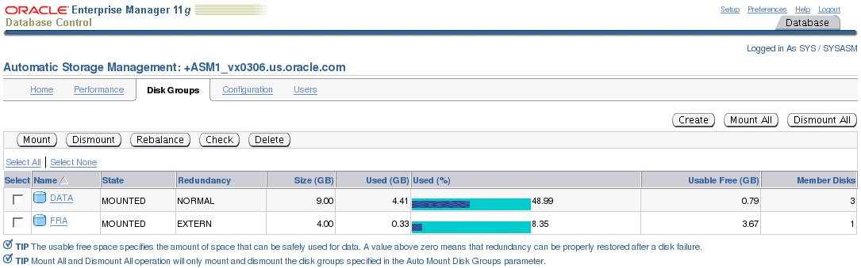
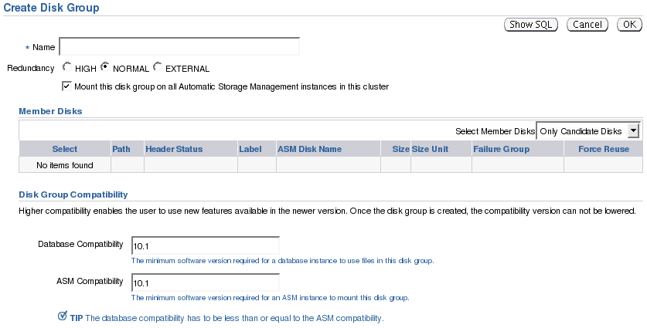
ASM Disk Groups with EM in RAC
Notes:
Oracle Database 11g: RAC Administration 4 - <number>
ASM Disk Groups with EM in RAC
When you add a new disk group from an ASM instance, this disk group is not automatically mounted by other ASM instances. If you want to mount the newly added disk group on all ASM instances, for example, by using SQL*Plus, then you need to manually mount the disk group on each ASM instance.
However, if you are using Enterprise Manager (EM) to add a disk group, then the disk group definition includes a check box to indicate whether the disk group is automatically mounted to all the ASM clustered database instances. This is also true when you mount and dismount ASM disk groups by using Database Control where you can use a check box to indicate which instances mount or dismount the ASM disk group.

Slide 41
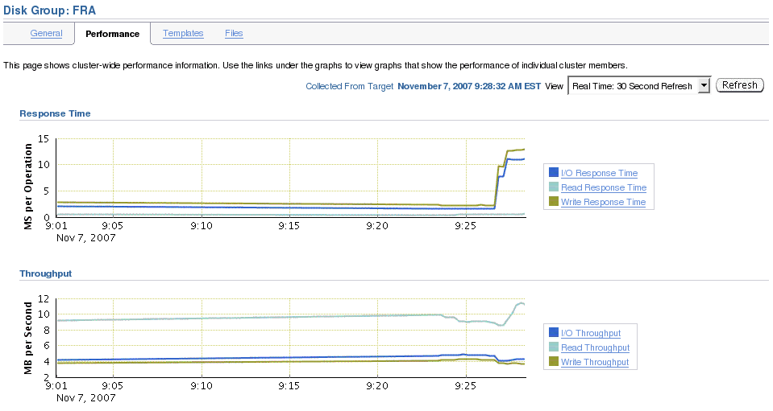
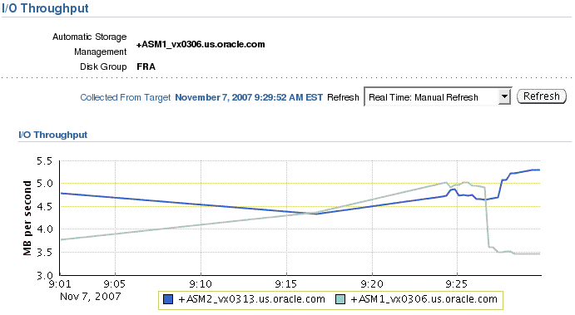
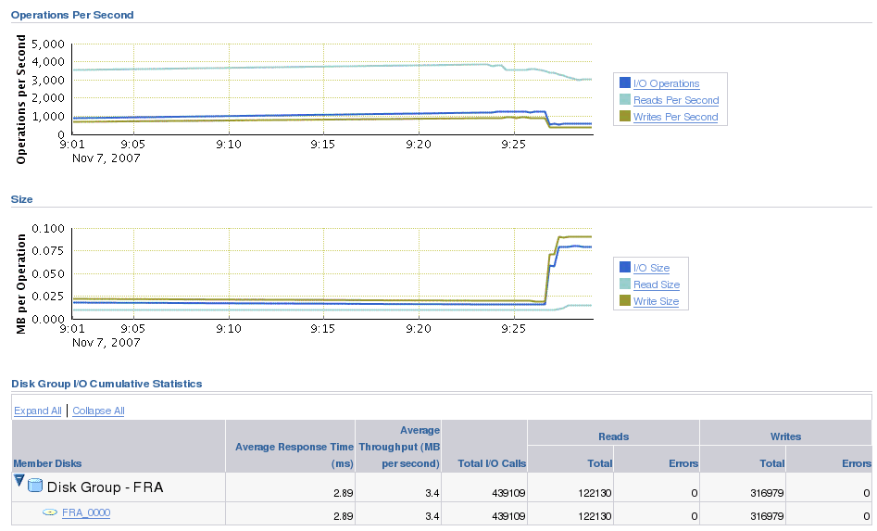
Disk Group Performance Page and RAC
Notes:
Oracle Database 11g: RAC Administration 4 - <number>
Disk Group Performance Page and RAC
On the Automatic Storage Management Performance page, click the Disk Group I/O Cumulative Statistics link in the Additional Monitoring Links section. On the Disk Group I/O Cumulative Statistics page, click the corresponding disk group name.
A performance page is displayed showing clusterwide performance information for the corresponding disk group.
By clicking one of the proposed links—for example, I/O Throughput on the slide—you can see an instance-level performance details graph as shown at the bottom of the slide.

Slide 42
Summary
In this lesson, you should have learned how to:
  Use Enterprise Manager cluster database pages
  Define redo log files in a RAC environment
  Define undo tablespaces in a RAC environment
  Start and stop RAC databases and instances
  Modify initialization parameters in a RAC environment
  Manage ASM instances in a RAC environment
Notes:
Oracle Database 11g: RAC Administration 4 - <number>

Slide 43
Practice 4: Overview
This practice covers manipulating redo threads.
Notes:
Oracle Database 11g: RAC Administration 4 - <number>

